Slide 1
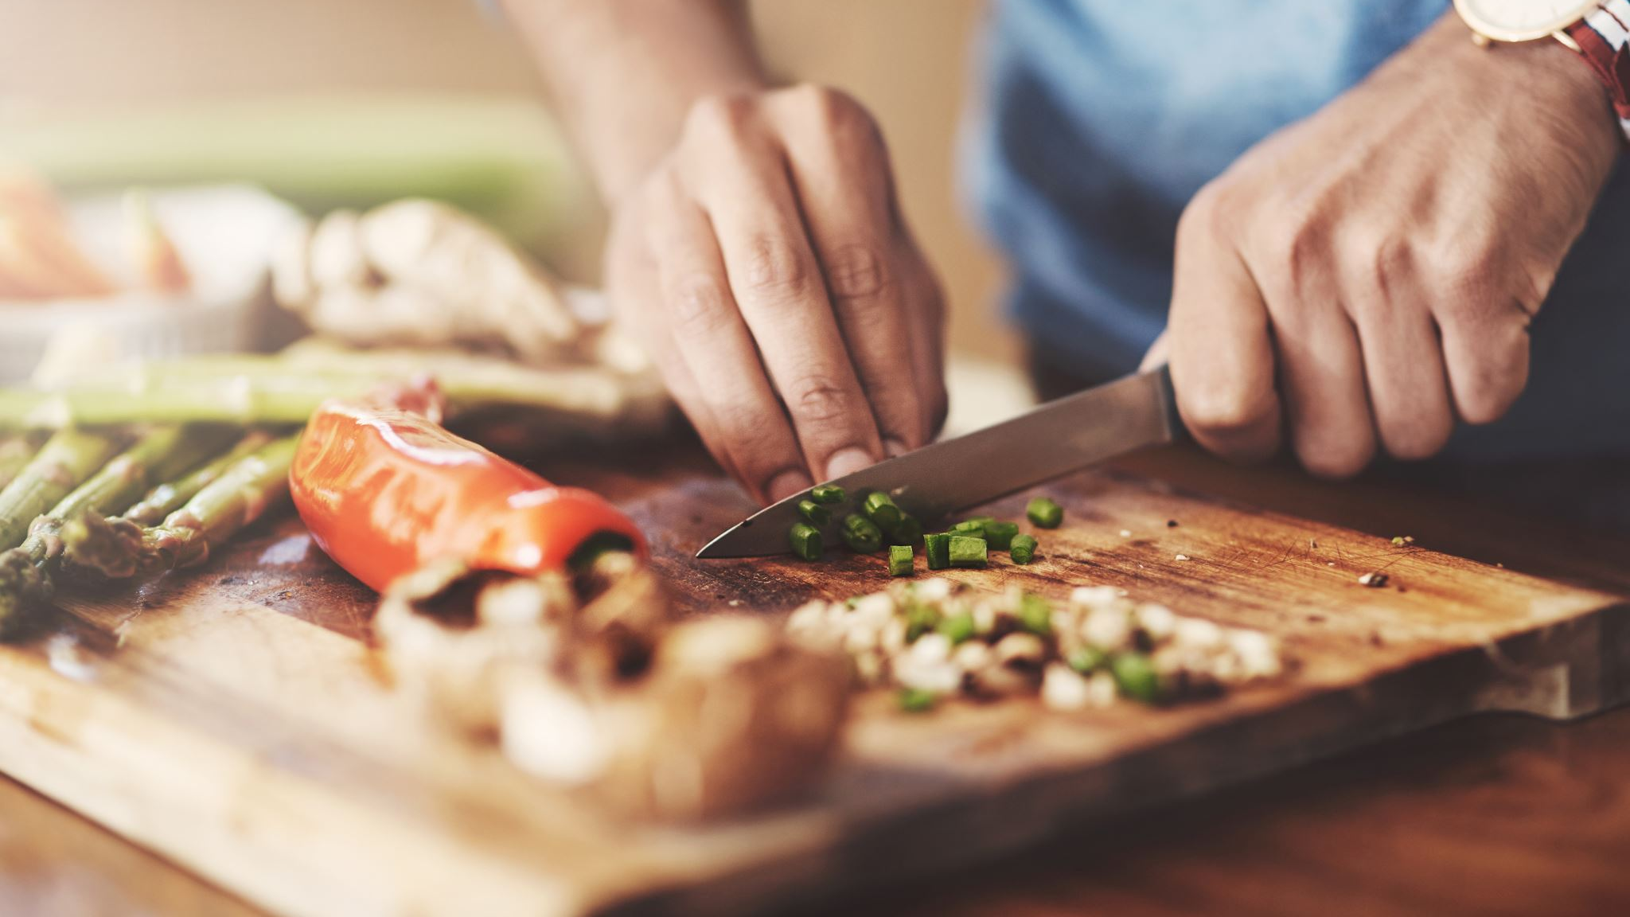
Cooking with Eric 👨‍🍳
Today’s Special:
Explainable Generative AI

Slide 2

Appetizer – What is Explainable GenAI? 🤔
Explainable AI (XAI): Techniques that make black-box AI decisions understandable
Origin: Emerged in 2010s to address lack of transparency in complex ML models (for example SHAP, LIME, saliency maps)
Why it matters: The goal is to build trust, have accountability, and supports ethical AI
”Fluent but non-factual."
Notes:
SHAP – Explains a model’s prediction by showing how much each feature contributed to the result.
LIME – Explains a single prediction by approximating the model locally with a simpler, interpretable one.
Saliency maps – Visualize which parts of the input most influenced the model’s decision.

Slide 3

🚨 Kitchen Rules 🚨 – Why GenXAI is important
Don’t Burn the Dish 🔥
Explanations help detect hallucinations before they spread
Know Your Ingredients 🥬
Lineage: trace where data comes from can prevent hidden bias
Adjust the Recipe for the Guest 👩‍🍳
Personalization: explanations adapt to different users
Keep the Kitchen Safe 🔒
Secure & cost-aware explanations prevent leaks and inefficiencies.
Always Taste Before Serving 🍴
Verification & uncertainty estimates to ensure there is trust before delivery
Notes:
Explainability prevents “fires” in GenAI by reducing risks and errors.
Key issues: hallucinations, bias, accountability, interactivity.
Rules map to needs like fact-checking, tracing data, personalizing explanations, protecting security, and admitting uncertainty.
GenXAI is necessary to build trust and keep systems safe.

Slide 4
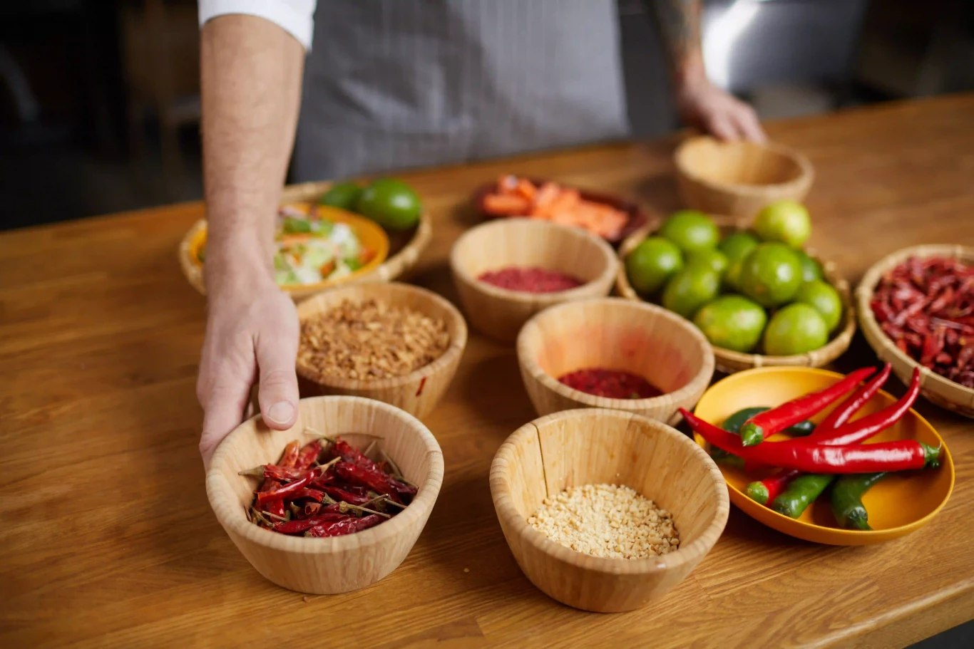
Ingredients – What Goes Into GenXAI 🥬🥩🥚
Generative AI produces text, images, code, video
Challenges in the kitchen:
Hallucinations (creation of made-up facts)
Bias (hidden in data)
Accountability (who’s responsible?)
Interactivity (conversations change)
Notes:
This slide explains why traditional XAI is not enough once we add Generative AI to the picture.

Slide 5

Let’s Mix It All Together 🍲

Slide 6

The Secret Recipe – Goals for GenXAI 🤫
Step 1: Add Verifiability
Detect and fact-check any hallucinations
Step 2: Stir in Lineage
Trace the origin of data & outputs
Step 3: Season with Personalization
Adapt explanations to different users
Step 4: Mix in Interactivity
Explanations evolve with user input
Step 5: Adjust Dynamically
Change explanations per context or sample
Step 6: Keep it Secure & Low-Cost
Don’t leak secrets and stay efficient
Step 7: Garnish with Uncertainty
Communicate confidence levels
Notes:
Verifiability – Explanations should help users check whether the model’s outputs are accurate.
Lineage – Explanations should show the origin of data and outputs.
Personalization – Explanations should adapt to the needs and background of different users.
Interactivity – Explanations should evolve with ongoing user input or dialogue.
Dynamic – Explanations should adjust based on the context, task, or sample.
Security & Costs – Explanations should protect sensitive data and remain efficient.
Uncertainty – Explanations should communicate how confident (or uncertain) the model is.

Slide 7
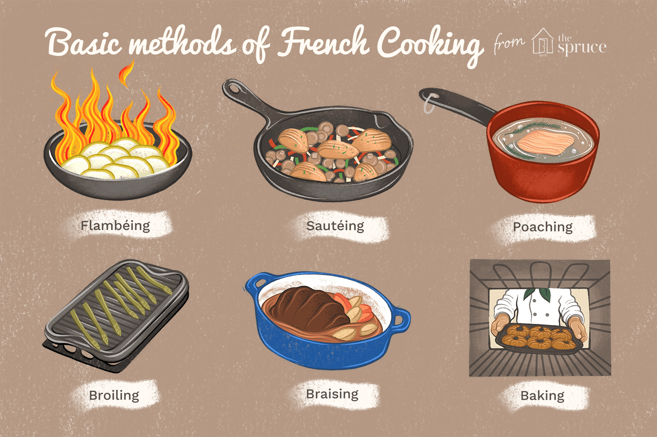
4 Ways to Cook GenXAI🍕🥗🍜🍪
🥦 Data-based Explanations
Reveal training data or examples (similar showing the ingredients used like a food label)
🍳 Model-based Explanations
Highlight interpretable components (layers and attention)
🍜 Prompt-based Explanations
Use chain-of-thought or rationale generation (like following a recipe step by step)
🍰 Self-explaining GenAI
Models generate their own explanations (the dish explains itself)
Notes:
Data-based explanations – Show similar training data or examples that justify the output. Example: An image generator shows which dog photos from its dataset influenced the result.
Model-based explanations – Highlight internal components like attention or layers to explain the output. Example: A text model points out it focused on the words “storm” and “warning” when predicting “hurricane.”
Prompt-based explanations – Provide reasoning as a step-by-step rationale. Example: For a math problem, the model explains: “First multiply the base, then apply the exponent.”
Self-explaining GenAI – The model automatically produces explanations with its outputs. Example: A chatbot answers a legal question and adds, “I based this on contract law principles of consideration and breach.”

Slide 8

How to Serve 💁🏻‍♂️
🍽️ Human-Centered Explanations
Narrative, accessible, and tailored
🥗 Evaluation Metrics
How do we measure a “good” explanation?
🍷 Interactivity
Adaptive explanations in real time
🥘 Real-World Applications
Healthcare, law, education, coding
Notes:
Human-centered explanations – Explanations should be tailored to the user’s background. Example: A doctor sees medical references, while a student gets a simplified summary.
Evaluation of explanations – We need metrics to judge explanation quality. Example: Does an explanation help a user make better decisions?
Interactivity – Explanations should adapt in real time as the conversation or task evolves. Example: A chatbot explains how your prompt changes its answer as you refine it.
Applications in high-stakes domains – GenXAI is especially important in healthcare, law, education, and coding. Example: In healthcare, explanations can help verify diagnoses and build trust with patients.

Slide 9

Final Touch & Dessert 🍰
✨ Final Touch GenAI has changed the recipe and added flavor because traditional XAI is not enough.
GenXAI needs verifiability, lineage, personalization, interactivity, and uncertainty
Multiple “cooking methods” help make outputs digestible
🍰 Dessert / Sweet Takeaway Trust and transparency are now on the menu.=
GenXAI = explanations that are not just clear, but human-centered and useful

Slide 10

Remember!

Slide 11
Artist Statement
For this assignment, I chose a cooking theme to explain my selected article because it introduces new ‘ingredients’ and ‘techniques’ needed for explainability in Generative AI.
Recipes show clear steps and safety rules, which to me mirrored how the authors describe the new objectives for GenXAI.
My submission and name can be shared publicly.

Slide 12
Appendix – References 🤓
Meske, C., Brenne, J., Uenal, E., Oelcer, S., & Doganguen, A. (2024). Explainable Generative AI (GenXAI): A Survey, Conceptualization, and Research Agenda. Artificial Intelligence Review. https://doi.org/10.1007/s10462-024-10916-x

